Slide 1



Short Term Accommodation

Slide 2
What is Short Term Accommodation?
Short Term Accommodation (STA), including respite, provides funding for participants to receive temporary supports and accommodation in a setting away from their usual home. STA helps participants maintain their independence, supports carers, and promotes social and daily living skills.
STA is designed to help informal supports continue their caring role. It is one option that provides participants and their informal supports time apart.
Generally, STA is funded for a group price, unless there is evidence the participant requires 1:1 supports due to disability.
STA is typically used:
For respite purposes
To support the participant while their usual supports are unavailable
As an opportunity to build skills, try new activities, and meet new people in a safe and supported environment
View More
…
Carisma Solutions confidential. Please do not distribute. ​

Slide 3
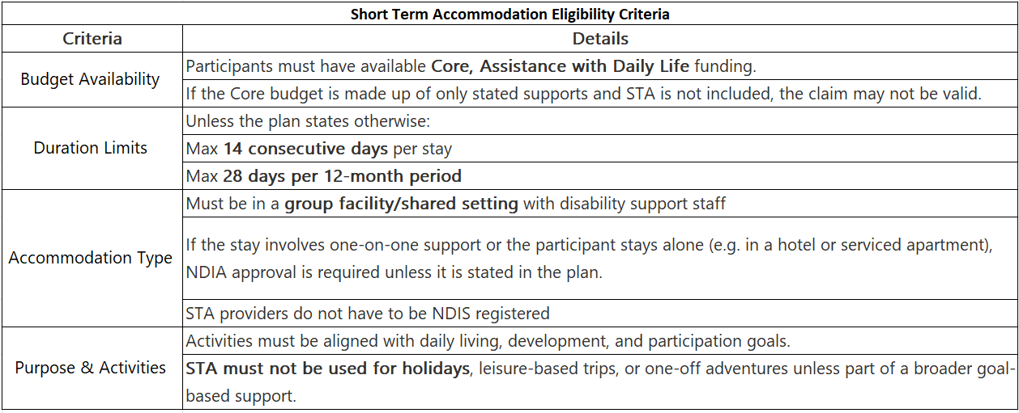
What is included in STA?
Short Term Accommodation line items cover all expenses including; supports for self-care, community access supports, accommodation, food and activities in a centre or group residence for short periods of time.
This includes agreed-upon activities in group settings, but it does not cover personal lifestyle costs, travel expenses, or leisure activities such as holidays. Providers should not charge for transport, activities, or meals on top of the STA rate when providing STA supports, even if charging under the maximum daily rate.
View More
Carisma Solutions confidential. Please do not distribute. ​

Slide 4
Ineligible Uses of STA
STA cannot be used to fund or enable:
Cruises or holiday packages
Tickets to events or general recreational experiences
Non-disability related travel or wellness services
Accommodation that is primarily tourism-focused (e.g. Airbnb, hotel)
One-on-one supports without prior NDIA approval
Medical appointments/events that are far from home
Unless specified in the plan, STA is generally not available to participants in Supported Independent Living (SIL), Specialist Disability Accommodation (SDA) or those who live alone, as they already have time apart from family and informal supports.
If the NDIS Planner or Delegate provides written permission for STA to be used in any of the above situations, this overrides the agencies general rules
Please use below link for STA invoice issues
STA - Invoice Processing
STA - Limitations & Service Agreements
Carisma Solutions confidential. Please do not distribute. ​
Further more details pls use below link
View More

Slide 5
Thank You
Rufus Stewart
Brigitte Schwartz
Benjamin Shah
Manager
Owner
Leader
Carisma Solutions confidential. Please do not distribute. ​

