Slide 1
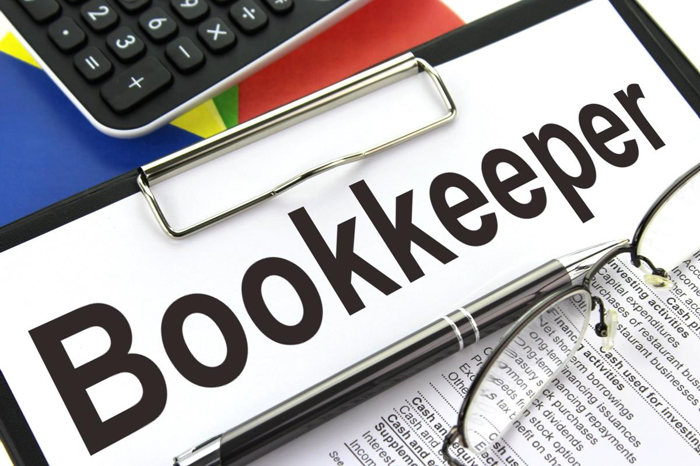
Presentation on Bookkeeping for Restaurants

Slide 2
Restaurant bookkeeping
One of the most complicated and time-consuming tasks for restaurant owners and managers is accounting.
Restaurants have expenses and transactions that are unique to them. And that necessarily makes restaurant accounting unique among the types of bookkeeping.

Slide 3
General Ledgers of Restaurants
Expenses
Revenue
Rebate on purchases
Other income
Other expenses
Sales
Cost of Goods Sold:
Consumables
Foods and beverages
Rent
Selling and distribution
Wages

Slide 4
An accountant has to maintain
Sales register
Salary Register
Inventory register
Purchase register

Slide 5
Purchase register
While processing bills, it has to be coded under appropriate general ledgers.
Sometimes, the supplier mentions wrong product description or sends less quantity.
For this, a credit note is issued and adjusted in the next bill payment.
Sometimes, The payment is duly made but the stock is yet to be delivered to the restaurant.
To avoid such situations, A signed copy of invoice from the restaurant Is requested.
Otherwise, the bill is kept in the approval tab of the accounting software. It is approved by the client before the payment is made.

Slide 6
Aged Payables
Payment for Aged payables has to be processed as per agreed terms. It could be weekly , fortnightly or monthly. Once the payment is made by the restaurant, batch payment and the remittance has to be sent.
Vendors are very crucial for any business .Restaurants are no exception. The payments shall be duly processed.
In case of urgent payments, bill is processed based on quotation for initial deposit the specified percentage of deposits is mandatory. Once the invoice is generated, we have to cross verify it.
If the payment is not processed, a mail has to be drafted saying the reasons. If it is not done, we could lose our supplier.
If the payment is not made, the supplier abruptly stops the supply. Unlike any other business, Restaurant business cannot survive without its stock since it is perishable in nature.

Slide 7
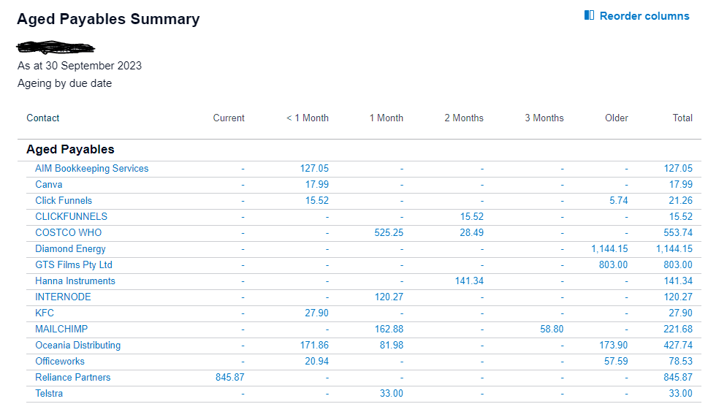

Example of aged payables summary in Xero

Slide 8
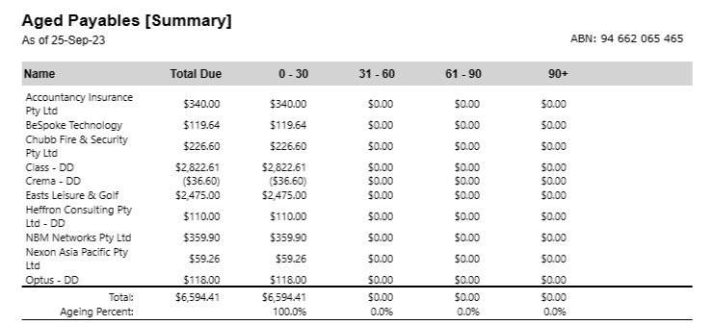
Example of aged payables summary in Myob

Slide 9
Point of sales (POS)
POS is the software and hardware restaurants use to take customers order, accept payments , manage food inventory and ultimately manage the entire operation.
Integrating POS software and accounting software, syncs and updates the data between the two systems, reducing the possibility of human error and allows real-time updates of transactions.
Example of POS software: Lightspeed, Square.
The POS software and the accounting software might show some variations. It has to be checked with reports like cashier report and reports generated in POS software.

Slide 10
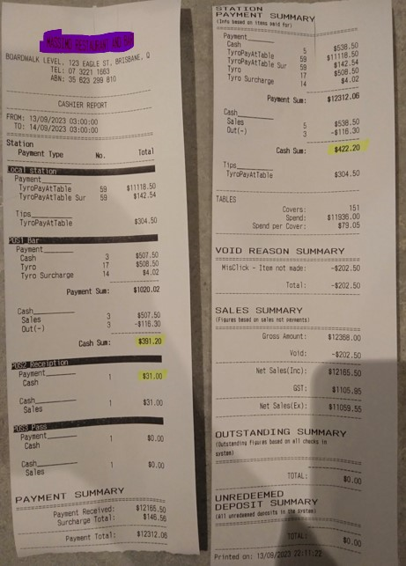


Slide 11
REBATE
The supplier gives a specified percentage of rebate to the restaurant. The percentage and the period is decided in the initial agreement .
The rebate is either given separately or it is adjusted with the due bills. In our books, we have to show it as “Other income”.

Slide 12
CONTRA
Contra is a barter transaction.
The restaurant provides contra for certain services enjoyed by them.
Instead of paying the service provider, The contra is practiced. The service provider can later enjoy the food provided by the restaurant without making payments.
The contra transactions are coded under the “contra” GL with specific names.
At the time of sales, it is coded under the same account to give a net effect.

Slide 13
Classes of Revenue for Restaurants
Revenue from Serving food
Revenue from ancillary goods
Revenue from non-operating activities

Slide 14
Revenue from ancillary services
Sale of packed products
Revenue from non-operating activities
Income of parking lots
Sale of scrap / PPE
Gaming revenue

Slide 15
Controls over cash collections
Cash count on daily basis
Cash Deposit to be made frequently
Cashier to maintain records of each cash transactions

Slide 16
Vouchers and Coupons
What is even restaurant business if it does not involve vouchers and coupons?
At the time of issuing vouchers, it has to be coded under “unclaimed gift voucher” account with BAS excluded.
While the customers use it, it will be included in the sales of food and beverages with GST on income.
While the payment entry is passed, the above-mentioned unclaimed gift voucher will be redeemed to give a net effect.

Slide 17
TIPS
In Australia, Tipping is not mandatory but culturally they’re tuned to it .
The tips that are received is not a part of restaurant’s revenue. It is added to the employee's income.
Even if it is not restaurant’s income, we have to keep track of it since it is a taxable income on the employee.
While the Tips are generated along with the sales, a credit note is used to close the account (To avoid showing it as income)

Slide 18
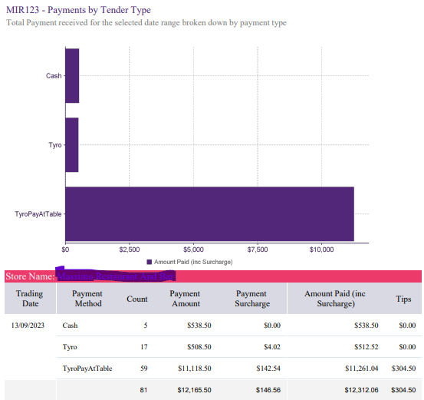
MIR123 Report

Slide 19
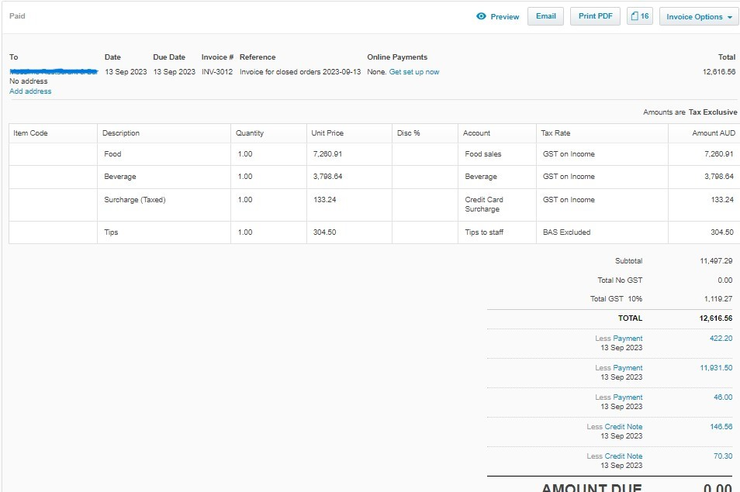
Picture of sales invoice in Xero

Slide 20
Pre-bookings
It is a common practice to prebook a table in restaurant.
At the time of booking , An account called “deposit sale” is created.
The details regarding the number of persons, dietary requirements ,orders is sent.
An invoice has to be created for the same and sent to the client.

Slide 21
An overview on payroll
Payroll is a critical component of any business, and restaurants are no exception. Payroll involves calculating employee hours , Award rates, taxes, and benefits, which can be a complex and time-consuming process.
Payroll has to be processed separately for back of the house and front of the house employees.
The Australian restaurant industry follows award rates which is set out minimum pay and conditions for employees.
These rates are set out by the fair work commission. The reason behind this is to ensure the compensation given to the employee is fair.
When the rates change, we have to ensure that the payroll system is updated to reflect the new rates. It changes from 1 July each year.

Slide 22
Classes of employees
Front of house
Employees interacting with customers comes under this category.
Back of house
Example – list runner, bartender , waitstaff.
All employees other than front end employees are back of the house employee
Example – Dishwasher, Kitchen hand, Chef.

Slide 23
Award rates
The award rates are set out by the fair works commission to ensure the compensation given to the employee is fair. Pay rates change from 1 July each year.
The payrates varies according to the age, employment type​ and the level.
Example:
Kitchen hand, Dishwasher comes under L1 level in Fair work rate sheet.
Wait staff, Bartenders comes under L2 level.
They are considered as casual employees.

Slide 24
GST ON FOOD
The goods and services tax (GST) is a tax of 10% on most goods and services sold or consumed in Australia
Not all food sales involve GST. WE need to know which items to charge GST on. Generally, WE need to include GST in the price of goods and services provided. These are called ‘taxable sales’.

Slide 25
GST on food
Examples of ‘taxable foods’ are : bakery products such as cakes, pastries and pies ,biscuits, cones and wafers savoury snacks such as potato chips n chocolates and lollies , ice cream , soft drinks and flavoured milk such as chocolate milk n food platters
Some examples of GST free foods are : Essentials like bread and bread rolls without icing or filling n cooking ingredients such as flour, sugar and cake mixes fats and oils for cooking milk, cream, cheese and eggs spices and sauces

Slide 26



