Slide 1
Tax offset
Directly reduce the income tax payable
Generally, two broad categories:
Non – refundable offsets
Applied against basic tax
Surplus cannot be refunded
Cannot be applied against Medical levy
Ex: most personal offsets (Low income, Foreign income, SAPTO)
Refundable offsets
Surplus refundable
Applied against Medical levy
Ex: Franking credit for residents
Private health insurance offset

Slide 2
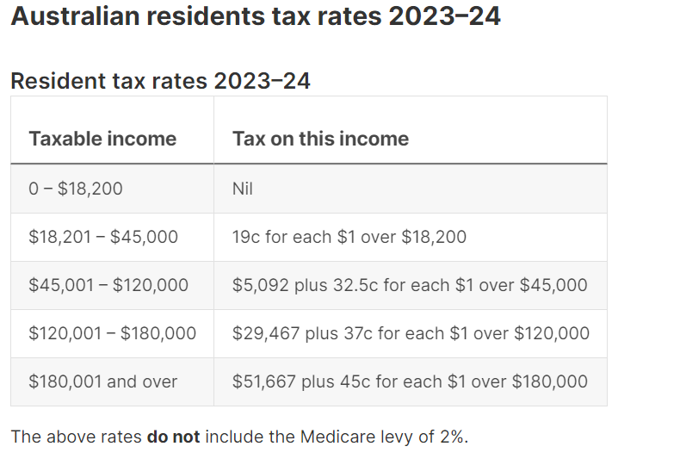
Maximum (Marginal rate) Tax in Australia for resident individual is = 45% + 2% = 47%

Slide 3
Tax payable calculation
Taxable income = 45,000
Basic income tax liability = 5,092
Less : Non- refundable tax offsets* = (5,092) eligible 6,000 wasted 908
Plus : Medicare Levy (2%) ** = 900
Less : Refundable tax offsets = (1,000)
Less : PAYGI + PAYGW = ( 900)
Tax payable or (refund due) = (1,000)
*surplus non-refundable offsets are wasted
** plus Medicare levy Surcharge and HELP Assessment Debt

Slide 4
Adjusted taxable income (ATI)
The eligibility of some offsets depends upon ATI and includes:
Taxable income
IT1 - Adjusted fringe benefits total
IT2 - Reportable employer super contributions
D12 - Deductible personal superannuation contributions
IT5 -Total net investment loss
IT6 - rental loss
Certain tax-free/exempt income (certain govt payment or exempt foreign income)
(Less: child support / maintenance)
= Rebate Income

Slide 5
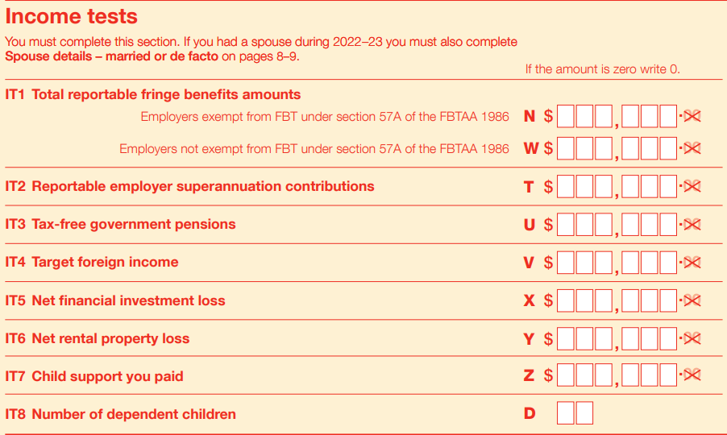

Slide 6
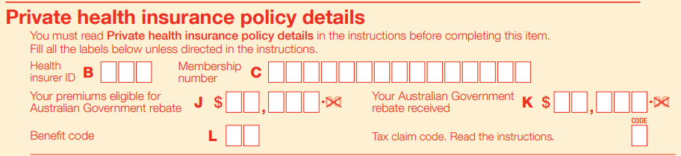
Private health insurance offset
Option to Reduced premium or claim as Refundable offset in TR
Offset is an amount the government contributes towards your private health insurance

Slide 7
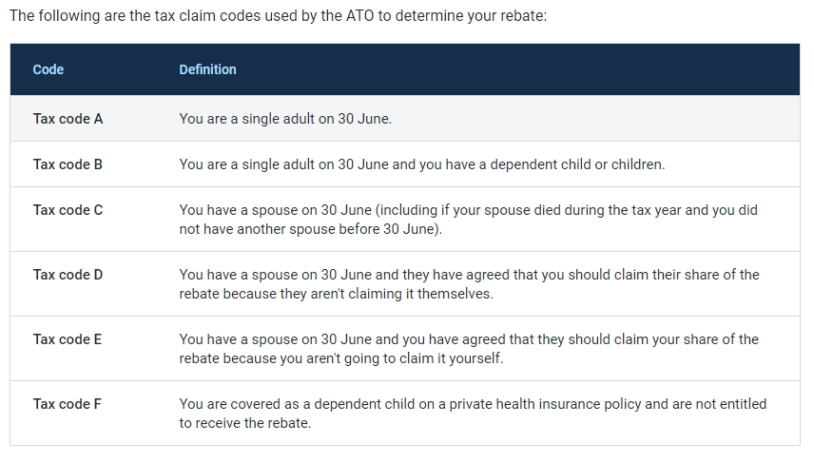

Slide 8
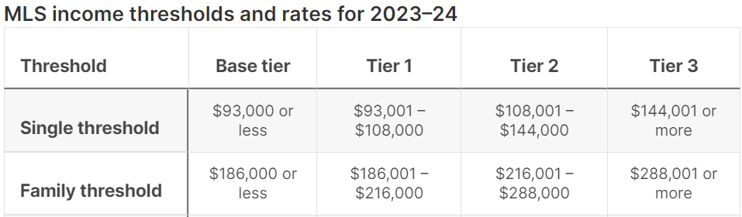
Private health insurance offset
  Generally, no offset if ATI falls under Tier 3
  Offset depends upon age and ATI MLS Threshold
  Calculated by TR software / Use ATO tool to calculate tax offset

Slide 9
Foreign income Tax offset (FITO)
Australian resident – Foreign income taxed in Australia
Foreign income – Foreign Tax paid/deemed to be paid (converted to AUD)
Relief provided via FITO (DTAA countries)
Non-Refundable offset but can be used to reduce Medical levy and MLS
Claim
  Up to $1,000 offset = no calculation up to foreign tax paid
  Above $1,000 offset = work out FITO (the software will calculate)

Slide 10
Foreign income Tax offset (FITO)
Above $1,000 offset = work out FITO (software will calculate)
So Net Tax paid = $5,092 - $4,750 = $342
 | Amount AUD | Tax AUD | Foreign Tax paid in AUD
Australian Taxable income | $20,000.00 | $342.00
Add : Net Foreign Income | $25,000.00 |  | $5,000.00
Total income | $45,000.00 | $5,092.00
Maximum FITO Excess tax paid due to Net FI |  | $4,750.00 | ($4,750)
Non carry forward (wasted) |  |  | $250

Slide 11
Franking tax offset (FTO)
Claiming Franking credit received in Franked dividend & Distribution
Refundable tax offset for individual but not for company
 | Franking Dividend (70%) (Accounting) | Franking Credit (30%) | Taxable Income (100%) | Suppose ABC company
A Pty Ltd | $7,000 | $3,000 | $10,000
B Pty Ltd | $14,000 | $6,000 | $20,000
Total | $21,000 | $9,000 | $30,000 | Loss
Ex. Tax on above is |  |  | $10,000
Less : FTO / Franking credit |  |  | $9,000 | $9,000
Net Tax payable |  |  | $1,000 | -
Excess Franking offset |  |  |  | $4,000
Convert to Loss CY Loss |  |  |  | (30,000)
$30,000 / 30% (CTR)

Slide 12
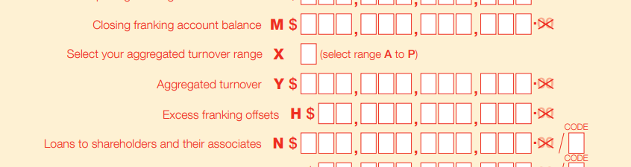
Company will convert this refundable tax offset into current year loss
This converted loss aggregated with CY loss ($30,000 + X)
Excess franking tax offset show in CTR 8H ($4,000)

Slide 13
Loss carry back tax offset
Condition
  Should be a Company, Limited Partnership & Public trading trust
  Small business entity in the year of loss or would have been a small business entity if aggregated turnover threshold was $5 billion
Made tax losses in the 2019–20, 2020–21, 2021–22 or 2022–23 income years
had an income tax liability for the 2018–19, 2019–20, 2020–21 or 2021–22 income years
Filed TR
Use ATO calculator
Refundable tax offset

Slide 14
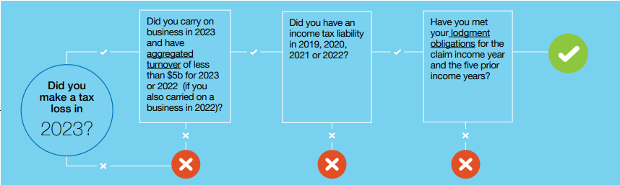
Loss carry back tax offset

Slide 15
Loss carry back tax offset
Limited to surplus in franking account
Losses can only be used once
Loss carry back tax offset calculation
Year |  | Amount | Tax (30%)
2020-21 | Loss incurred | $(100,000.00) | $(30,000.00)
 | Convert to positive amount for comparison |  | $ 30,000.00 | A
Loss carry back to
2018-19 | Income Tax liability |  | $ 20,000.00
2019-20 | Income Tax liability |  | $ 20,000.00
 | Total |  | $ 40,000.00 | B
 | Franking account balance |  | $ 25,000.00 | C
 | Loss carry back tax offset |  | $ 25,000.00
 | (Minimum of A / B / C)

Slide 16
T1 - Seniors and pensioners tax offset (SAPTO)
Non-Refundable offset
Condition 1
A. Income in L6
  an Australian Government pension or allowance from Centrelink
  a pension, allowance or benefit from the Department of Veterans’ Affairs (DVA)
or
B. If no Income in L6
  Met Centrelink pension age / Veteran pension age (60yr old)
  Eligible but not received pension due to income or assets tests
  Met Residency rules (10yr {5yr continuous}) / Veteran or met any other condition

Slide 17
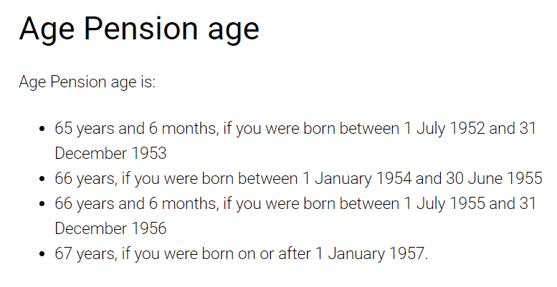

Slide 18
T1 - Seniors and pensioners tax offset (SAPTO)
Condition 2
Rebate Income (Taxable income + IT1 + IT2 + D12 + IT5 + IT6)
 | Rebate / *Combined Rebate income | Maximum tax offset
Single | Less than $50,119 | $2,230
Couple | Less than $83,580* | $1,602 each
Couple lived apart due to illness | Less than $95,198* | $2,040 each

Slide 19
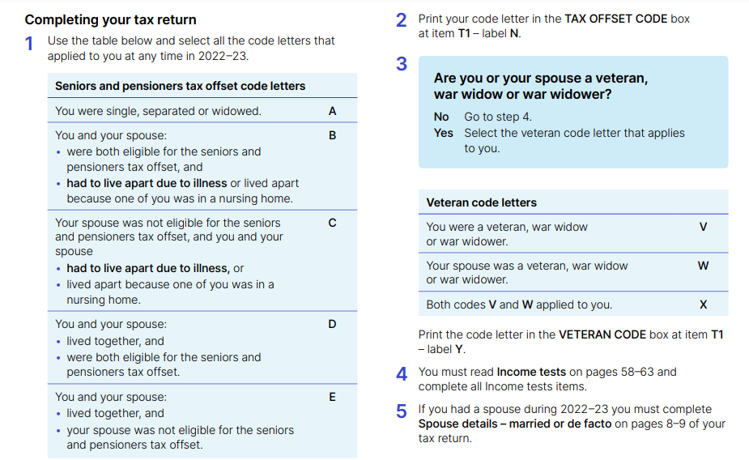

Slide 20
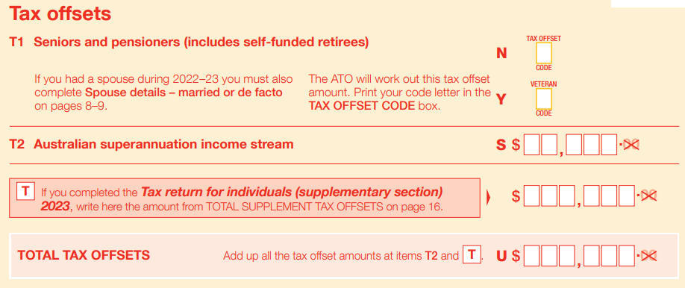

Slide 21
T2 – Australian superannuation income stream
Series of regular payments from your super fund (L7)
Eligible for tax offset
  15% of the taxed element
  10% of the untaxed element (Max $10,625)
No tax offset For taxed element – receiving before Preservation age except death / disability
No tax offset For untaxed element - receiving before 60yr except death + died after turned 60yr

Slide 22
Taxation of superfund
Entry : Contribution
Earning
Exit : Benefit released
Not Taxable in SF
Taxable in SF
Taxable in SF
Non Concessional
(Limit $1,10,000 subject super balance and age)
Concessional $27,500
(15% taxed)
D12 & DIV293
Taxed & Untaxed elements
Tax free component

Slide 23
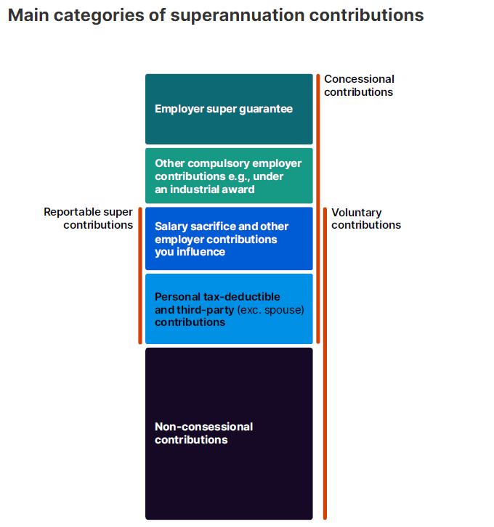

Slide 24
T2 – Australian superannuation income stream
Offset in PAYG Pay., Sum.,
 | Member >= 60 | Member at preservation age but < 60 | Member < preservation age
Taxed element | Tax-free | Marginal rates less 15% offset | Marginal rates
Untaxed element | Marginal rates less 10% offset | Marginal rates | Marginal rates
Subject to capped defined benefit separate calculation
Marginal rate means slab rate
Member means Individual / Beneficiary of deceased

Slide 25
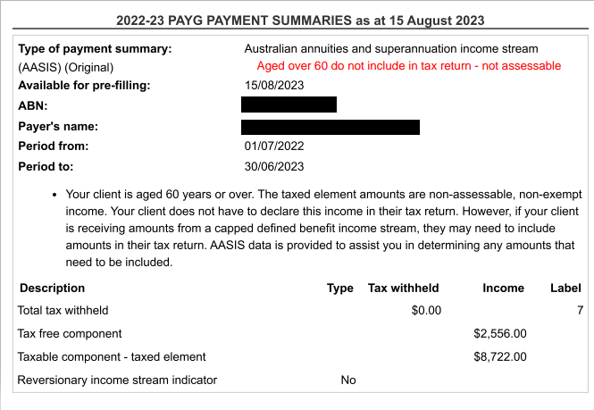

Slide 26
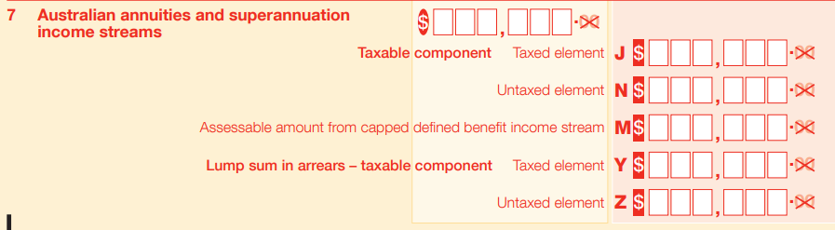
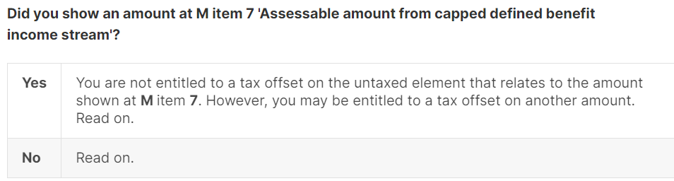

Slide 27
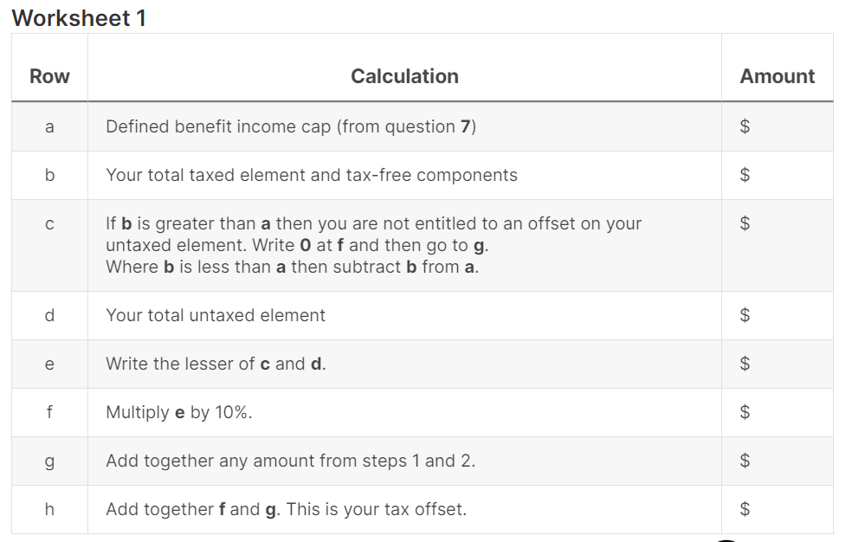
Tax offset Calculation
10000
5000
5000
6000
5000
500
1000
1500
10000
11000
0
6000
6000
600
1000
1600
Tax offsets shown on your pay., sum. for Member at preservation age but < 60
Show in S at T2

Slide 28
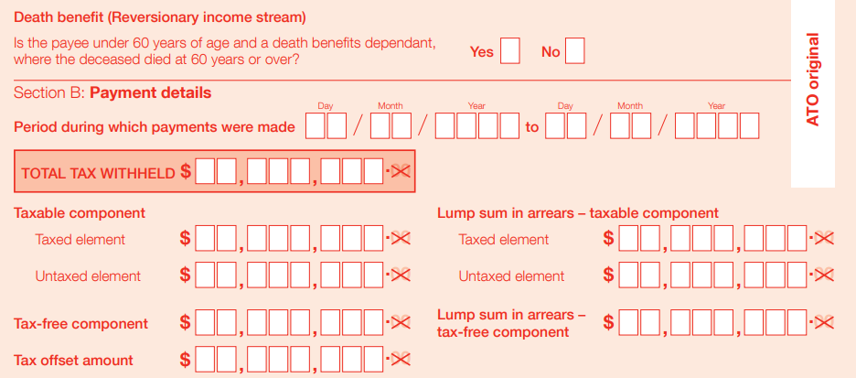
PAYG payment summary – superannuation income stream
10,000
10,000
3,589
Only relating to Taxed element Member at preservation age but < 60

Slide 30
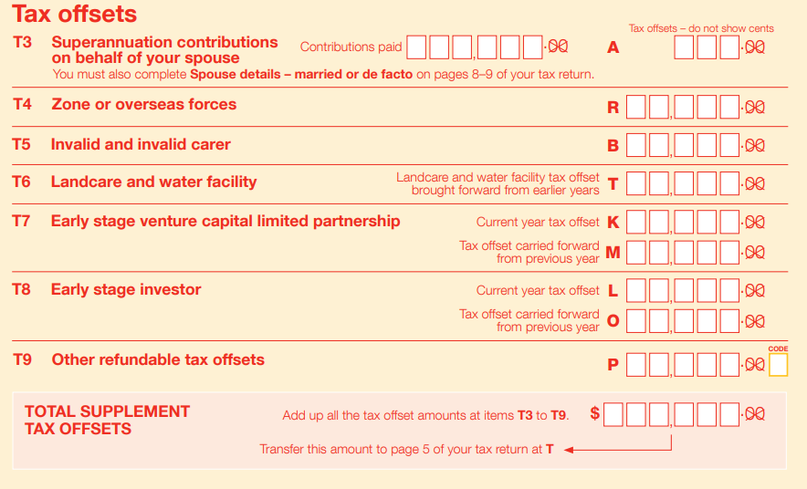

Slide 31
T3 – Superannuation contributions on behalf of your spouse
Contribution to complying super fund or retirement savings account
No deduction claimed in D12
Spouse’s Taxable + IT1 + IT2 income does not exceed $40,000
Spouse’s total super balance should not > 1.9 Million as at 30.06.2023
Spouse’s non-concessional contribution should not exceed limit ($110K)
Maximum tax offset $540 ($3000 * 18%)

Slide 32
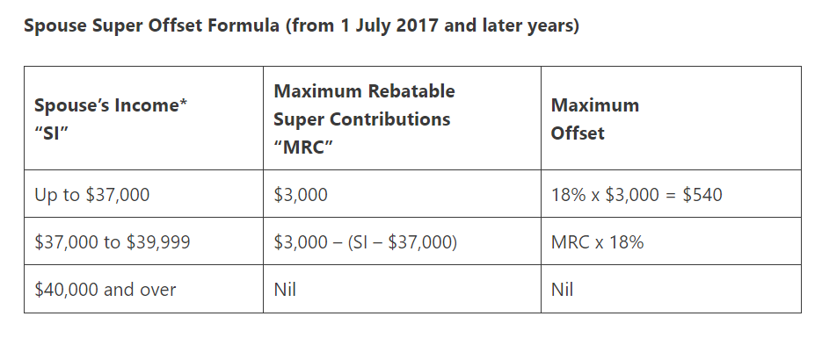
T3 – Superannuation contributions on behalf of your spouse
*Spouse’ income = Spouse’s Taxable + IT1 + IT2 income

Slide 33
T4 - Zone and overseas forces tax offsets
Zone tax offset
As a compensation for difficult climate / Isolation / higher cost of living
Taxpayer residing in isolated areas
  Usual place of residence in the zone > half the tax year (>183 day)
  Excludes fly in, fly out (FIFO) employees
  ZONE A (worst affected area)
  ZONE B (less badly affected area)
  Non Refundable tax offset

Slide 34
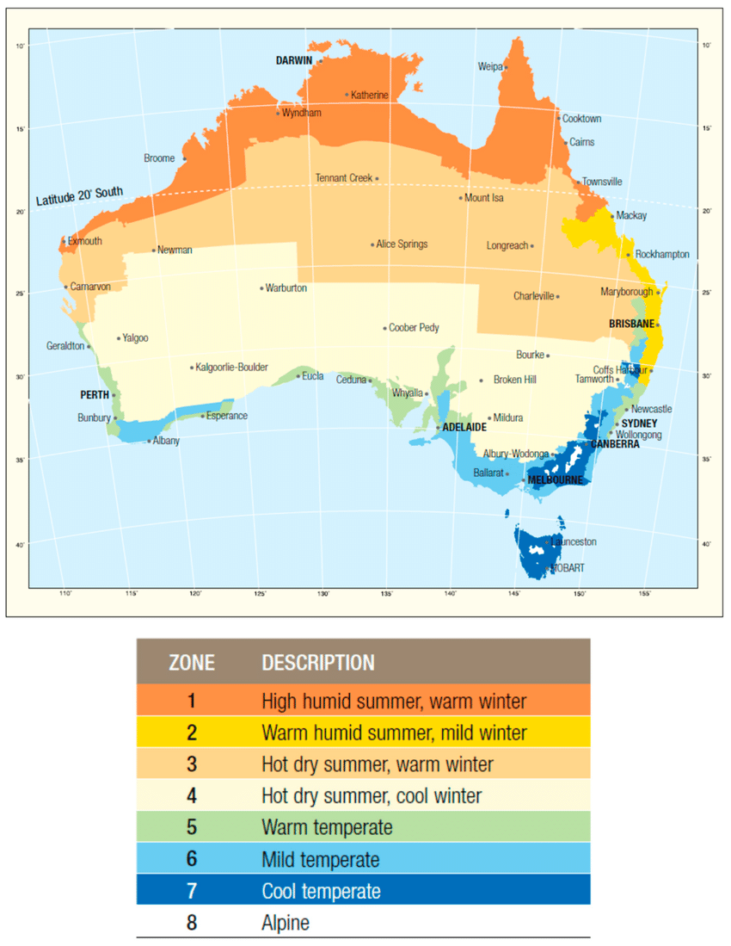

Slide 35
T4 - Zone and overseas forces tax offsets
Overseas forces tax offsets
  Non Refundable tax offset
  Member of Australian Defense Force / a United Nations armed force
  You serve in a specified overseas locality
  Full tax offset if served 183 days or more
  Part tax offset if served < 183 days
  Use ATO calculator to calculate offset

Slide 36
T5 – Dependent invalid and carer offset (DICTO)
Non Refundable tax offset
Maintaining one or more dependents who are genuinely unable to work due to invalidity or carer obligations
Such dependent should be as family member and 16 old or older
Must be in receipts of support pension / allowance from government
Family ATI <= $104,432, use ATO calculator to calculate offset

Slide 37
T6 – Landcare and water facility Offset
Non Refundable tax offset
For primary producers only
Refer NOA or amended NOA for excess unused or offset
This brought forward amount needs to be mentioned in T6

Slide 38
T7 – Early stage venture capital limited partnership (ESVCLP) Tax Offset
Structured as Limited partnership
General partner – fund manager. Limited partner – Investor.
Makes equity investments (EVCI) in eligible Australian start-up and growth companies
Maximum Tax offset 10% on contribution made (ref Distribution St.)
Non Refundable but carried forward offset
Income & Capital gain on disposal of EVCI not subject to tax for Australian resident or resident of country that has DTA with Australia
Details of Exempt income & Tax offset mentioned in partnership distribution statement

Slide 39
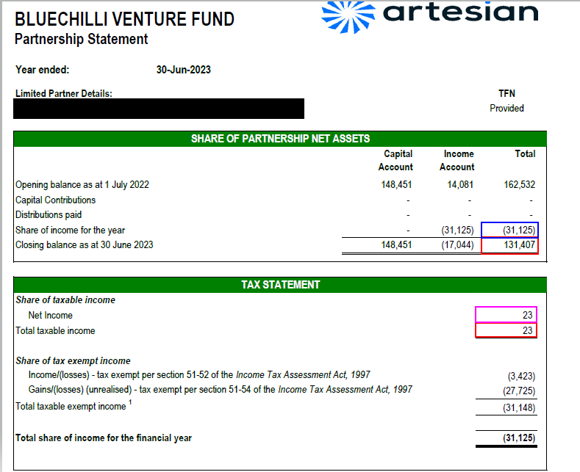

Slide 40
T8 – Early stage investor (Angel Investor)
Condition
  New share purchase
  In a qualifying Early Stage Innovation Company (ESIC) from 1.07.2016
Tax offset is 20% on eligible investment
Eligibility use ATO tool to determine
Sophisticated investor Max tax offset $2,00,000 others $50,000 (including affiliates).
Non Refundable but carried forward offset
Capital gain or loss may be disregarded held >= 12months & < 10years
Investor Vs Venture Capitalist

Slide 41
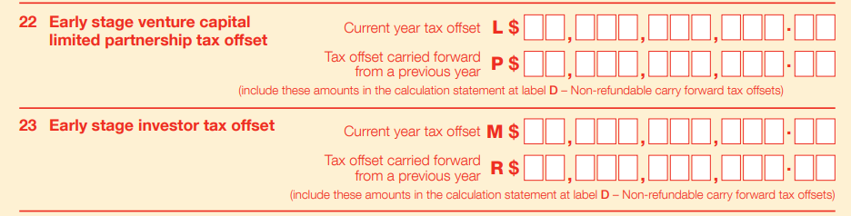
In Company TR

Slide 42
T9 – Other Offsets
Exploration Credits received from trust or partnership
Refundable tax offset for Individual & SMSF
For individuals claim in T9
For company claim in Franking account as Franking credit and pass on
For Trust or Partnership – show in distribution statement and pass on
For SMSF claim in TR as offset

Slide 43
Other super tax offset
Low income super tax offset
Eligibility income $37,000 or less
Maximum offset $500
No disclosure in TR
ATO will calculate offset and make payment to superfund directly
Veterans' super (invalidity pension) tax offset
a non-refundable tax offset
This tax offset ensures veterans and their beneficiaries don't pay more tax because of the Douglas court decision.
It applies from the 2007–08 income year.
No disclosure in TR, ATO will calculate and consider offset in NOA

Slide 44
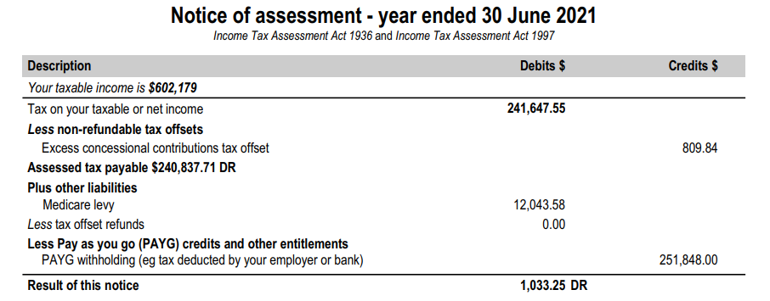

Slide 45
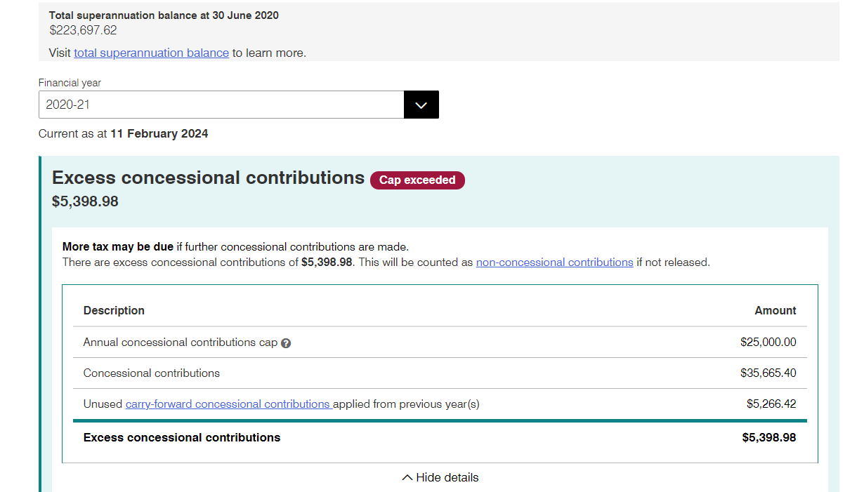
5,398.98 * 15% = 809.84

Slide 46
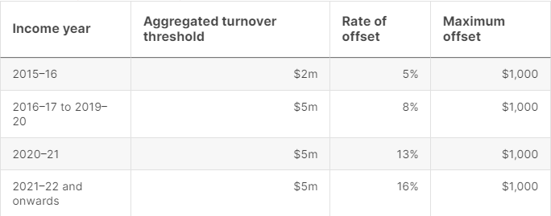
Small business income tax offset
Maximum offset is $1,000 per year
Eligibility
  small business (aggregated turnover of less than $5 million)
    as a sole trader
    share of net small business income from a partnership or trust.

Slide 47
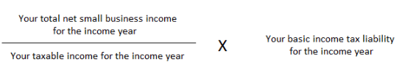
Working out your offset
Maximum offset limit is $1,000
Net small business income =$ 5,000
Taxable income = $10,000
Income tax liability = $ 3,000
Small Business tax offset calculation = 5000/10000 * 3000
Small business tax offset amount = $1,500 but max $1,000

