Slide 1

General Audit Procedures

Slide 2
Audit Planning
An audit plan helps to determine a general strategy and a detailed approach for the expected nature, timing, and extent of the audit.
Helps the auditor ensure that appropriate attention is devoted to important areas of the audit, that potential problems are identified and that the work is completed in a timely manner.
The auditor should develop & document an audit plan describing the expected scope & conduct of the audit. The precise form & content will vary depending on the size of the entity, the complexity of the audit & the GENERAL methodology & technology used by the auditor.

Slide 3
Audit Materiality & Risk Assessment
As identified in AUS 202 “Objective & General Principles Governing an Audit of a Financial report” –The objective of an audit of a financial report is to enable the auditor to express an opinion whether the financial report is prepared, in all “material” respects, in accordance with an identified financial reporting framework.
The auditor shall design and perform risk assessment procedures to obtain audit evidence that provides an appropriate basis for:
Identification & assessment of risks of material misstatement, whether due to fraud or error, at the financial report & assertion levels; and
To design further audit procedures in accordance with ASA 330

Slide 4
Audit Assertions and Procedures
Audit assertions can provide auditors the clues on potential misstatement that may occur on the financial statements. Likewise, auditors usually perform different types of audit procedures to test various audit assertions.
Audit assertions that auditors need to test in the audit procedures include:
Class of transactions | Account balances | Present and disclosure
Occurrence Completeness Cut-off Classification | Existence Rights and obligations Completeness Valuation and allocation | Occurrence Completeness Classification and understandability Accuracy and valuation
For example, auditors may perform the audit procedure on fixed assets addition by vouching a sample of new items in fixed assets register to the supporting documents. This procedure tests the occurrence assertion of fixed assets addition.
Meanwhile, auditors may test the completeness assertion of fixed assets by performing audit procedure of:
tracing the physical fixed assets to fixed assets register and
reconciling the fixed assets register to the general ledger

Slide 5
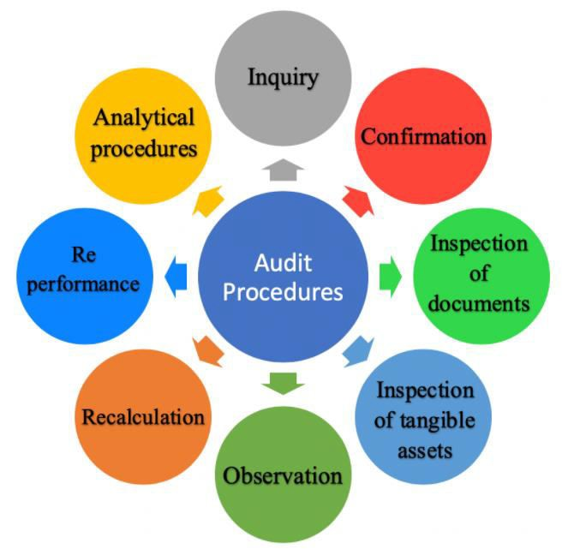
Eight types of Audit procedures

Slide 6







AUDIT PROCEDURES
Develop an Audit plan considering various factors such as the size of a Audit, the identified level of risk, the availability of required records, and the complexity of issues that arise during the audit.
Review the control
Of Cash and Bank.
Determine the effectiveness of any internal control procedures.
Obtain an understanding about the nature, purpose and existence of the Audit.
Obtain an understanding about the nature, purpose and existence of the Audit.
Obtain an understanding
about the nature, purpose,
and the existence of the Audit.
Discuss items with relevant staff to obtain clarification or further information.
Ensure all incomes and expenses accrued were with respect to the proper cut-off period.
Conduct Risk assessment
Procedures and find Audit
Materiality .

Slide 7
GENERAL AUDIT PROCEDURES
Particulars | Source Documents | Audit Procedures
Cash and Bank | Bank Statement for the year end & subsequent bank statements. Bank Reconciliation Statement Bank Confirmations | Obtain Source documents Match Reconciliation ending balance with statement ending balance and General Ledger balance Please confirm whether there are any outstanding cheques or deposits in transit that are there in the bank reconciliation. And then, have a look at the subsequent month bank statement and if any unusual large amount is noted, raise a query to the client asking for a supporting document for the transaction.

Slide 8
GENERAL AUDIT PROCEDURES
Particulars | Source Documents | Audit Procedures
Accounts Receivable | Aged receivable detailed and summary listing for the year end. Subsequent month bank support. If the receivables are exceeded over 90 days, then we need the collectability status for the same. | Obtain the above source document. Match the Aged receivable listing ending balance with the General Ledger balance. If any material variance is noted find the reason of it and update the client about the variance. As per the materiality levels the AR testing template goes through a certain number of samples, to be tested. Select the samples and raise query for invoice or supporting document and subsequent bank support to check whether the amount has been received or not.
Prepayments | Prepayment reconciliation for the year end. Supporting invoices. | Obtain the above source documents. As per the supporting invoices provided calculate the prepaid period from the year end. And calculate the per day amount by dividing it by total number of days accordingly. Then multiply the prepaid number of days with the per day amount and match with the General Ledger balance. If any material variance is noted find the reason of it and update the client about the variance. Ensure its presentation as per IAS 1 Presentation of Financial Statements.

Slide 9
GENERAL AUDIT PROCEDURES
Particulars | Source Documents | Audit Procedures
Fixed Assets | Depreciation schedule Assets addition invoices (If any improvement happened in CY). | Recalculate the client given depreciation schedule. Ensure accounting policy is in accordance with IAS 16 PPE. Verify the recalculated amount to the general ledger. In case of any material change need to confirm with the client.
Inventories | Purchase orders Supporting invoices Creditor confirmations | Obtain Source documents Ensure accounting policy is in accordance with IAS 2 Inventories. Match inventory purchases with purchase orders made and reconcile with supporting invoices. Ensure purchase of inventories Approved by appropriate authority. Conduct stock verification at irregular intervals.

Slide 10
GENERAL AUDIT PROCEDURES
Particulars | Source Documents | Audit Procedures
Intangible Assets | Amortization schedule . | perform substantive tests to determine that the intangible assets exist by reviewing appropriate documentation. Ensure IAS 38 Intangible assets were followed. Recalculate Amortization Schedule Verify the recalculated amount to the general ledger. In case of any material change need to confirm with the client.
Accruals | Accrual reconciliation for the year end | Recalculate material accruals based on source reports / documents. Investigate any material variances. Identify expense accounts that give risk to accruals (i.e., invoiced after the service has been provided) and assess if an accrual is required. Process adjustments where necessary. Compare prior year accruals with current year accruals and assess if any accruals are unrecorded as at balance date.

Slide 11
GENERAL AUDIT PROCEDURES
Particulars | Source Documents | Audit Procedures
Accounts Payable or Trade Payables | Aged payable detailed and summary listing for the year end. | Obtain the above source document. Match the Aged Payables listing ending balance with the General Ledger balance. If any material variance is noted find the reason for it and update the client about the variance. Search for unrecorded liabilities in the audit test that auditors perform to verify if the payables are understated due to the liabilities having not been recorded. This type of audit test is usually performed to respond to the risk of understatement of liabilities. Select a materiality threshold for review of invoices - to review all invoices over this value (i.e., specific performance materiality or performance materiality). Obtain all unpaid invoices as at testing date. Review invoices for any liabilities relating to the audited FY. Reconcile recorded liabilities. Process adjustments were required. Obtain all invoices paid since balance date as at testing date. Review invoices for any liabilities relating to the audited FY. Reconcile recorded liabilities. Process adjustments were required. Assess the coverage obtained over valuation and assess the need for further testing (e.g., supplier statement testing).

Slide 12
GENERAL AUDIT PROCEDURES
Particulars | Source Documents | Audit Procedures
Loan | Loan statement. Confirmation. Amortization schedule. | Check whether it’s a Short term or long term loan by verifying the loan agreement. Ensure accounting policies as per IFRS 9 Financial instruments were followed. Compare the loan statement ending balance to the general ledger balance. Recalculate the interest and principal payments paid in amortization schedule and verify with the general ledger.

Slide 13
GENERAL AUDIT PROCEDURES
Particulars | Source Documents | Audit Procedures
Revenue | contract agreement. Resident revenue statement or invoices. Payment support. | Obtain the above source documents. Select a sample of revenue contracts according to the materiality level. Select 5% of contracts for second + year clients or 10% of contracts for first year clients. Select at least one old, one new and the rest by random number generator Select a month to test for payment to bank. After receiving the samples, with the use of revenue reconciliation workpaper perform the test. Ensure entity follows IFRS 15 Revenue from contracts with customers. Conduct an SAR (Substantive analytical review) on Recurrent charges Select a month to test for payment to bank and Review invoice. Extrapolate the revenue for 12 months and compare the balance with the TB balance. If any material variance is noted find the reason of it and update the client about the variance.

Slide 14
GENERAL AUDIT PROCEDURES
Particulars | Source Documents | Audit Procedures
Other Income | Agreements (if any) | Substantive Analytical Procedures include the consideration of whether any specific circumstances are arising that could result in the generation of Other Income. One example of this would be government aids. This will prompt the auditor to anticipate an increase in the Other Income balance and further investigation should be carried out if the expectation is not met.
Expenses | Agreements or Supporting's (if any) | Split the total expenses into three classifications. 1. Repairs and Maintenance Other and SAR. Repairs and Maintenance and Other. Select a sample of R&M and Other invoices by utilizing Substantive Sample Sizes Worksheet (R&M Expenses) and selecting a sample. Select a month to test for payment to bank. Review invoices as per worksheets including Repairs versus maintenance SAR (Substantive Analytical Review) Select a sample of SAR expenses by GL review. Review invoices as per worksheets. Extrapolate the expenses for one year and compare the expense balance with the GL balance.

Slide 15
GENERAL AUDIT PROCEDURES
Particulars | Source Documents | Audit Procedures
Payroll | Employees signed contracts. Tax File Number declaration. 4 pay runs selected haphazardly (one from each quarter). From each pay run selected, 2 employees to be selected haphazardly. Employee list with start and termination date. Allocation and methodology for labor/wages cost shared among other Operator villages. Payroll reconciliation. Work care levy supporting document. | Identify new staff within the year. Obtain contracts and other relevant staff documents like Superannuation TFN Bank details. Confirm pay rate agrees to the Employee Contract Conclude Select 5 employees left during the year. Check employee file for finishing documents such as letter of resignation/ Termination and final payout calculations. Haphazardly select 5 payruns and test to ensure that the bank remittance report had been signed by GM and that the payroll totals report, and the total amount paid on the bank agree and time sheet hours agree to the hours paid, and staff members net salary agrees to the batch pay.
Depreciation | Fixed Assets register Depreciation schedule Assets addition invoices (If any improvement happened in CY). Purchase invoices | Ensure whether depreciation has been calculated from the date, the asset is available for its usage. Ensure depreciation calculation is in accordance with IAS 16 PPE. Check whether depreciation is ceased for a particular asset which was sold.

Slide 16
GENERAL AUDIT PROCEDURES
Particulars | Source Documents | Audit Procedures
Finance Costs | Financial agreements, Bank payments. | Obtain Source documents. Verify whether it’s a short term or long-term financial liability. Check interest payments corresponding conditions as per financial agreements. Ensure accounting policies were in accordance with IFRS 9 Financial Instruments.
Borrowing Costs | Loan agreements, Bank payments | Obtain source documents. Identify whether the asset is a qualifying asset as per IAS 23 Borrowing costs and accounting policies were followed correctly.
Leave Provision | Employee agreements with Employees | Obtain Source documents. Obtain employees’ job history and reconcile it with time sheets. Check whether there were any changes in Employees leave policy. Select samples from Employees list randomly and recalculate leave provisions to verify whether it matches General Ledger balances.

Slide 17
Conclusion:
GENERAL AUDIT PROCEDURES
General audit procedures are essential for ensuring the accuracy, reliability, and compliance of financial statements. They provide a systematic approach to assessing and verifying the integrity of an organization's financial operations. By following these procedures, auditors can identify potential risks, detect discrepancies, and offer recommendations for improving internal controls. Ultimately, these procedures contribute to fostering trust and transparency in financial reporting, aiding stakeholders in making informed decisions.

Slide 18

Thankyou

