Slide 1

Setting up an SMSF, Trust Deed, Trustees & Members

Slide 2

Contents
Introduction
Setting up an SMSF
Trust Deed
Trustees
Members
Conclusion

Slide 3

Setting up an SMSF
Consider appointing professionals to help you
Choose individual trustees or a corporate trustee
Appoint your trustees or directors
Create the trust and trust deed
Check your fund is an Australian super fund
Register your fund and get an ABN
Set up a bank account
Get an electronic service address
Prepare an exit strategy

Slide 4

Individual Trustee and Corporate Trustee
Individual Trustee
There must be 2 trustees.
One trustee must be a fund member.
If the fund member is an employee of the other trustee, the fund member and the other trustee must be relatives.
Corporate Trustee
The corporate trustee company can have one or 2 directors, but no more.
The fund member must be the sole director or one of the 2 directors.
If there are 2 directors and the fund member is an employee of the other director, the fund member and the other director must be relatives.

Slide 5
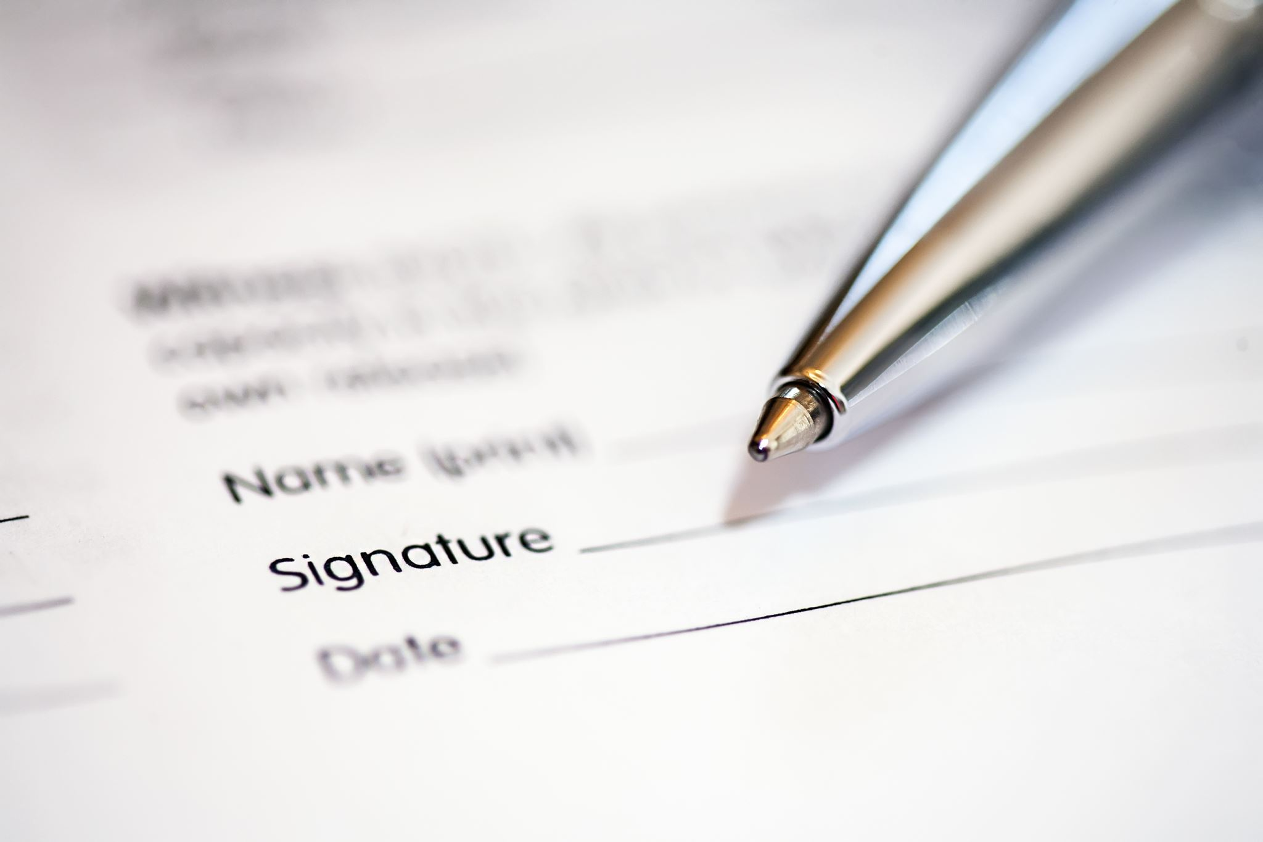
Create the trust and trust deed
A trust is an arrangement where a person or company (the trustee) holds assets (trust property) in trust for the benefit of others (the beneficiaries).
A super fund is a special type of trust, set up and maintained for the sole purpose of providing retirement benefits to its members (the beneficiaries).
Trust Deed
prepared by someone competent to do so as it's a legal document
signed and dated by all trustees
properly executed according to state or territory laws
regularly reviewed,and updated as necessary.

Slide 6
Check your fund is an Australian super fund
The fund was established in Australia, or at least one of its assets is located in Australia.
The central management and control of the fund is ordinarily in Australia. This means the SMSF's strategic decisions are regularly made, and high-level duties and activities are performed, in Australia. It includes
  formulating the investment strategy of the fund
  reviewing the performance of the fund's investments
  formulating a strategy for the prudential management of any reserves, and
  determining how assets are to be used for member benefits.
The fund either has no active members or it has active members who are Australian residents and who hold at least 50% of either
  the total market value of the fund's assets attributable to super interests, or
  the sum of the amounts that would be payable to active members if they decided to leave the fund.

Slide 7
Get an electronic service address
If your self-managed super fund (SMSF) receives contributions from employers (other than related-party employers), it needs to be able to receive the contributions and associated SuperStream data electronically.
From 1 October 2021, your fund will need to use SuperStream to rollover any super to or from your SMSF.
SuperStream is a data and payment standard that applies to super transactions (including contributions made by employers and rollovers between funds) to any super fund, including SMSFs.
To receive SuperStream data, you need an electronic service address (ESA), (this is a special internet address, different to an email address).

Slide 8

Prepare an exit strategy
Even when you're setting up your SMSF you need to consider what happens when your SMSF ends, or 'winds up'.
Sometimes SMSFs become difficult to manage because of an unexpected event such as:
a relationship breakdown between the trustees
an illness or accident that leaves a trustee incapacitated (and unable to perform their role as a trustee)
a trustee dies.

Slide 9
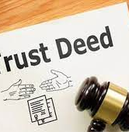
TRUST DEED
A trust deed is a legal document that sets out the rules for establishing and operating your fund.
The main objective is that the trust should be created for a lawful purpose.
It includes such things as the fund’s objectives, who can be a member and whether benefits can be paid as a lump sum or income stream.
The Trust Deed outlines the governing rules of your SMSF and contains information including:
Name of the fund and the trustee(s)
Rules governing the contributions
Rules governing the benefit payments.

Slide 10

TRUST DEED
The Trust Deed can be amended any time, but the Trustee must follow the guidelines that are set out in the original Trust Deed of the SMSF.
A deed of trust will include the same type of information stated in a mortgage document, such as:
The identities of the borrower, lender, and trustee. A
full description of the property to be placed in trust.
Any restrictions or requirements on the use of the property while it is in trust.
Formation of the trust– A minimum of two trustees are required to form a trust. No restriction is imposed on the maximum number of trustees.
However, all trustees should be over 18 years of age with valid ID proofs.

Slide 11
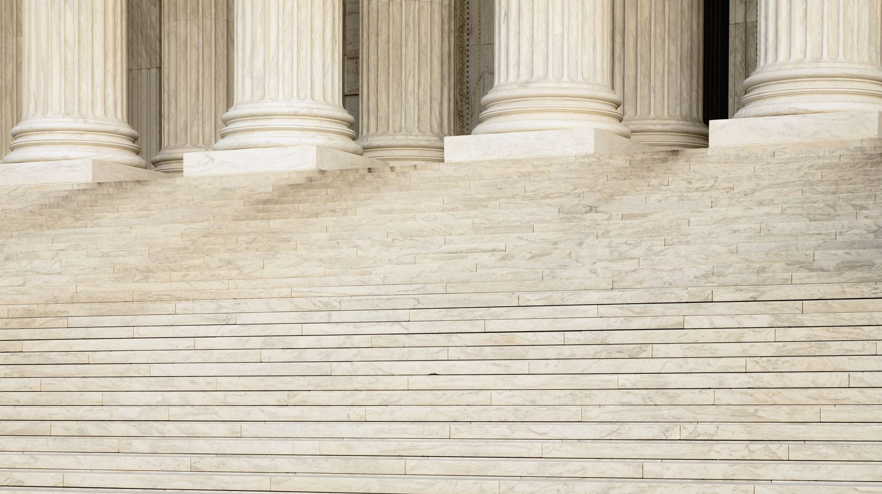
TRUSTEES
a natural or legal person to whom property is legally committed to be administered for the benefit of a beneficiary (such as a person or a charitable organization)
one (such as a corporate director) occupying a position of trust and performing functions comparable to those of a trustee.
There are two SMSF trustee structures, one where the trustees work in their individual capacity and another where a company is appointed as the trustee.
In both cases, it's the members who run the fund and as a general rule, all members are either trustees themselves or directors of the corporate trustee.

Slide 12
TRUSTEES
A trustee must follow the investment guidelines and make sure that she does not break relevant rules, including:
Providing financial assistance to members or family members, such as giving a loan to pay the school fee.
Except for some special circumstances, avoid purchasing assets from members or related parties.
Except for some limited circumstances, don’t borrow money.
In-house assets (loan or investment in a related party of the fund) should not exceed more than 5% of investments of the SMSF.
Don’t enter into investments or selling fund assets on a non-arm’s length basis.

Slide 13
TRUSTEE DECLARATIONS
Appoint an ASIC-approved SMSF auditor to audit the SMSF
Protect the assets of the SMSF
Avoid any contract or work that will prevent from performing duties as a trustee of the fund
Make sure to lodge the annual return of the SMSF with the ATO before the deadline.

Slide 14
MEMBERS
Your SMSF can have no more than six members. As a member, you are a trustee of the fund — or you can get a corporate trustee.
In either case, you are responsible for the fund.
While having control over your own super can be appealing, it's a lot of work and comes with risks.
Can you have a single Member SMSF?
Yes, but you have to have either:
a private company as a Trustee (also known as a Corporate Trustee), or
a second Trustee (a natural person) resident in Australia, with a TFN, who has no criminal convictions and is not a bankrupt.

Slide 15
QUESTIONS ??

Slide 16

CONCLUSION

Slide 17


